Slide 1
KEI INDUSTRIES LIMITED
www.kei-ind.com

Slide 2
Structure
Major Highlights
About Us
Key Strengths
Industry Prospects
Growth Drivers
Business Overview
Future Outlook
Financials
Share Holding Pattern
Notes:
Content
Background information
Summary
Personal resources and goals
The product or service
The market
Sale and marketing plan
Management & organisation
Development of the business
Budgets
Financial requirements
Appendices

Slide 3
Major Highlights
ET 500 2017 KEI ranking improve to 380 against previous ranking 405
ICRA Ltd has upgraded long term rating A from A-(A Minus)and short term rating A1 from A2+
During FY17-18 Growth in Net Sales 29%, In PAT 54% over last year
During Q1 FY 18-19 Growth in Net Sales 13.68% , PAT 17.12%
Cable division Growth approx. 25% in value and approx.18% in Volume in FY17-18
Strong Order Book of Rs. 2599 Cr – EPC Rs. 1290 Cr, Cable Rs. 1390 Cr and L1/LOI EPC Rs. 884 Cr , Cable Rs. 708 Cr
Insurance of Receivables to mitigate risk
Improvement in Order Book to lead to increase in turnover and Profitability.

Slide 4
Major Highlights
Healthy Brand Visibility – TV Advt, IPL Rajasthan Royals, Customer Loyalty and Preferences.
Super Brand Status 2011-1016
Diversified business profile across customers, industries and manufacturing locations.
Increase focus on Exports, Retail segments and EHV to support expected improvement in turnover, profitability as well as working capital.
Very Strong relationship with banks.
Highly committed promoters and management.

Slide 5
About Us
Diversified and de-risked business model across :
Markets: Domestic & International
Segments: Institutional & Retail
Sectors: Private & Public
Established presence in the EHV, MV & LV cables coupled with retail wires and cables
Established presence in the EPC in T&D
Listed at BSE, NSE & CSE also listed Overseas at Luxembourg Stock Exchange
Market Capitalization of Rs.3600 Cr approx .
Q1 18-19 Net Sales of Rs. 883.90 Cr against Rs. 777.97 Cr in Q1 FY 2017-18.
EBIDTA of Rs.87.27 Cr in Q1 FY 2018-19 against Rs. 78.36 Cr in Q1 FY 2017-18 .
ROE 27% against 23% and ROCE 31% against 28% in FY 2017-18.
Headquarters at New Delhi, India.
Manufacturing facilities at Bhiwadi, Chopanki ,Pathreri (Rajasthan) & Silvassa (D & NH)
More than 2000 employees, & 2900 contract labour across the Country
KEI Industries Limited is engaged in the business of manufacturing and marketing of EHV, MV and LV power cables & House Wire
Ventured into Engineering, Procurement and Construction (EPC)
Ranked amongst the top three cable manufacturing companies in India
ISO 9001:2015 , ISO 14001:2015, OHSAS 18001:2007, ISO/IEC 10025:2005 certified company

Slide 6
Milestones
1968 : Established as a partnership firm
1968 : Commenced manufacture of switch board cables for DOT
1985 : Commenced the manufacture of Control, Instrumentation and Thermocouple Cables
1992 : Partnership firm converted into Public Limited Company
1993 : Added manufacturing of PVC/XLPE Power cables up to 3.3 KV
1994 : Diversified into stainless steel drawings with pilot plant
1995 : Issued first IPO. Became Listed Co.
1996 : Installed major SSW plant at Bhiwadi.
1997 : Added another Plant at Bhiwadi for PVC /XLPE- LT power cables
2001 : Commenced manufacturing of rubber cables upto 11 kV
2002 : Established JFTC Plant at Silvassa
2004 : Converted JFTC Plant at Silvassa into manufacturing of existing range of cables – rebalancing act`
2005 : Issued GDR of USD 10 million
2006 : Added new project for manufacturing 33 kV HT cables
2006 : Implemented ERP Baan S/W system in the organization to ensure transparency and efficiency
2006 : Issued FCCB of USD 36 million

Slide 7
Milestones
2007 : Commenced New Project at Chopanki and modernization / expansion at Bhiwadi & Silvassa unit
2007 : Received prestigious Corporate Governance Rating
2008 : Successfully commissioned 100% EOU at Chopanki for LT power cables
2009 : Successfully completed the up gradation of HT cable capacity at Bhiwadi & Chopanki up to 66 kV
2010 : Technical Know - how Agreement with BRUGG KABEL A.G., Switzerland for EHV cables ranging from 66kV to 220kV
2010 : Commercial Production of EHV cables ranging from 66kV to 220 kV
2010 : Proud recipient of Business Super brand Award for Industry Validated
2011 : Certification of ISO 9001:2008, OHSAS 18001:2007, OHSAS 14001:2004
2011 : Receipt of EHV cable order from KPTCL worth Rs75 Crores
2011: Successful redemption of FCCBs in
November.
2012: Receipt of EHV order of Rs.138 crores
from UPRNL
2012: Proud recipient of Super Brand status
for consumer validated
2013-14: New office at Singapore, Nigeria, Kazakhstan.
2014-15 Strengthened Retail Network
2015-16 EPC contract for Sub Station of 220KV
2016-17 EHV upto 400 KV Commissioned

Slide 8
Key Strengths
Wide product basket comprising:
Extra High Voltage cables up to & including 400 kV
High & Medium Voltage cables
Low Tension cables
Control and instrumentation cables
Specialty cables
Rubber cables
Winding, Flexibles and house wires
Submersible cables,
OVC/poly wrapped winding wires
Stainless steel wires
Engineering, Procurement and Construction (EPC)
Helping the company service a wide spectrum of sectors such as power, oil refineries, railways, automobiles, cement, steel, fertilizers, textile and real estate, amongst others

Slide 9
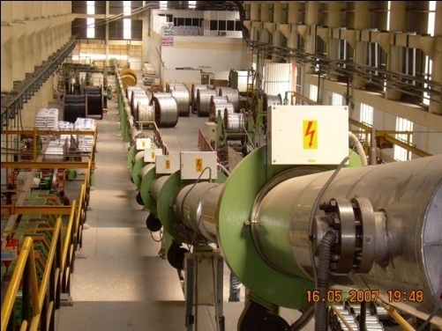
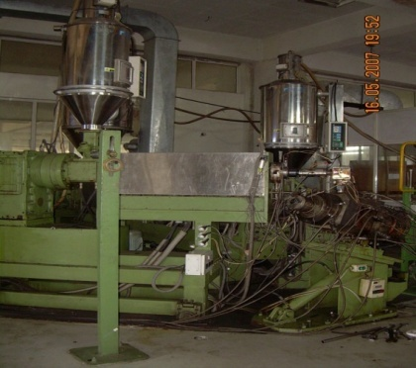
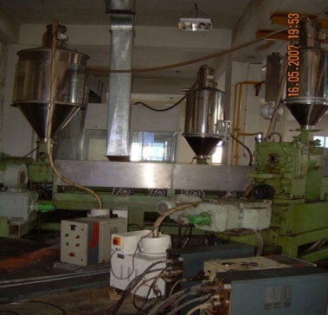
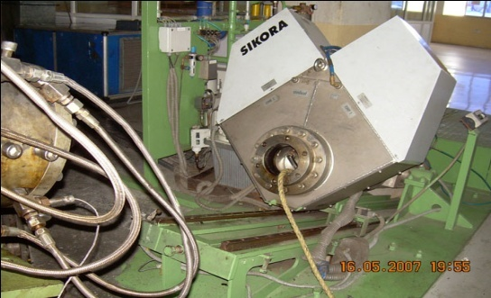
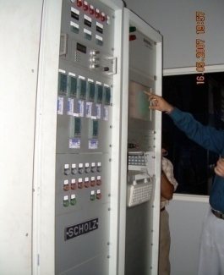
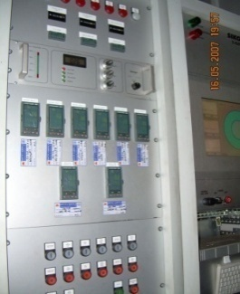
Key Strengths : Bhiwadi Unit
Manufacturing prowess evident from:
World-class manufacturing facilities at Bhiwadi (Raj.), Silvassa (D&N H) and Chopanki (Raj.)
CCV Line (Involving Dry Cure Dry Cool technology) For manufacturing HT Cables Up to 132 kV
Sikora Online X-Ray Machine Used for Monitoring Product Quality

Slide 10
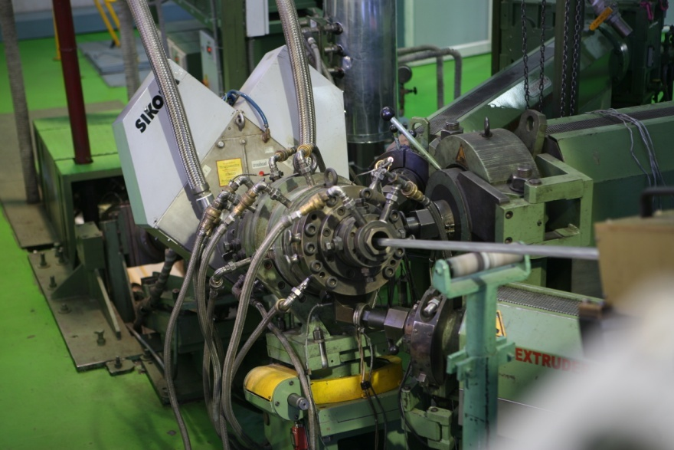
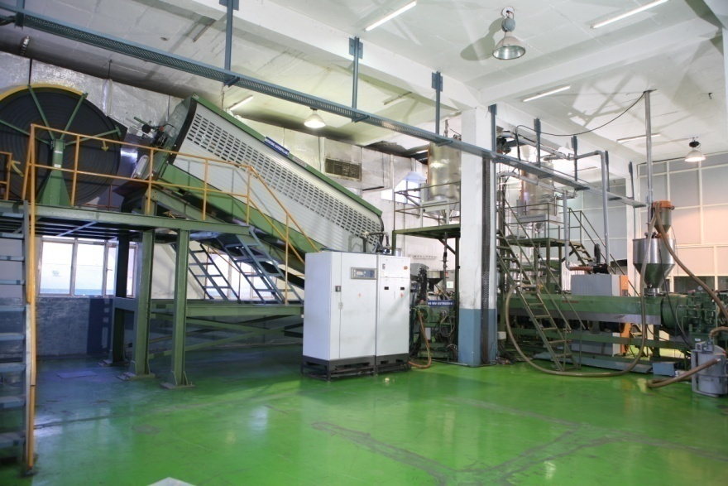
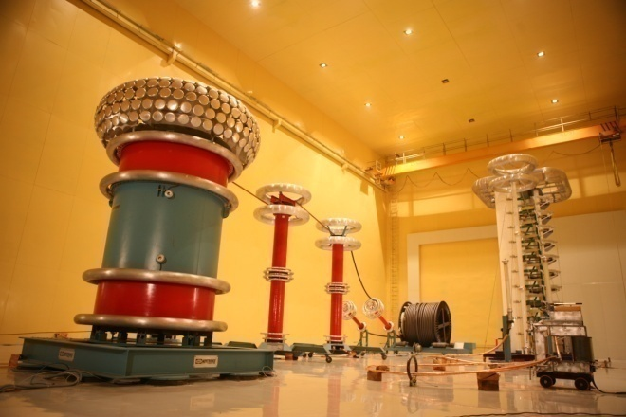
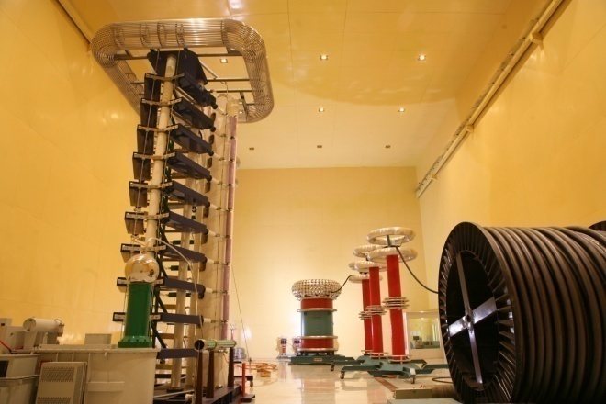
Key Strengths: Chopanki Unit
Troester’s CCV Line (Involving Dry Cure Dry Cool technology) For manufacturing EHV Cables Up to 220 kV
In-house Testing Facilities for Testing EHV Cables

Slide 11
Key Strengths
Equipped with an installed capacity of:
900 kms of EHV Cables
7500 kms of HT Cables
94000 kms of LT Cables
3600 Kms of Rubber Cable
817000 km of Winding, Flexibles & House Wires
6000 MT of Stainless Steel Wire
During Q1 F.Y. 2018-19 Capacity utilization is 76% in Cable division , HW/FW 81% and SS division 98%.
Strategically located manufacturing facilities at Bhiwadi, Chopanki,Pathreri and Silvassa results in servicing Institutional clients efficiently across the country

Slide 12
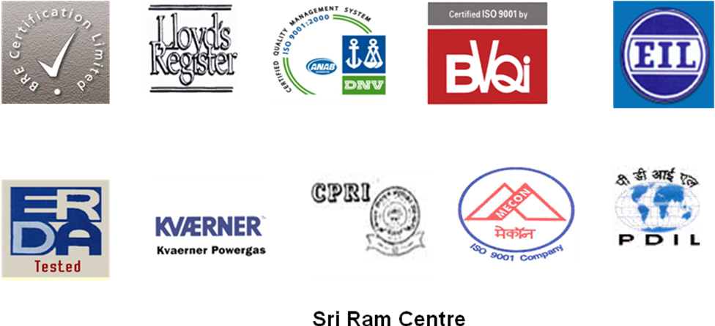
Key Strengths
Commitment to quality
Adherence to the most stringent quality standards laid down by
Vindicating the KEI’s superior production process, technology and quality products
Strong research capabilities
Constantly enhancing product portfolio by investing in R&D
Results in niche product offerings
Ability to customize solutions for clients
Expertise to manufacture specialty cables including braided cables, fire survival and zero halogen cables

Slide 13
Key Strengths
Climbing up the value spectrum
Commercial Production of EHV cable & 400 KV Cable under testing after trial production
Result in pre-qualifying KEI to participate in large utility tenders
Firm impetus to its turnkey EPC business, which consumes significant portion of EHV cables & HT , LT Cable
Backward integration through in house PVC/XLPE Compound Manufacturing
Establishing presence in the retail segment
Building awareness as a brand in house wires
Embarked upon aggressive marketing through various brand promotion activities through various communication channels
KEI aims to dominate retail trade with visibility & presence

Slide 14
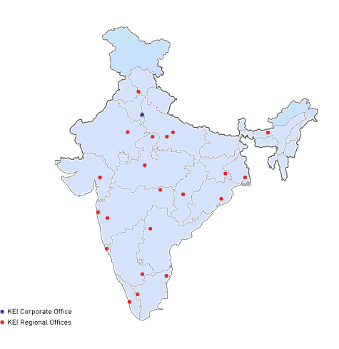
Key Strengths
Well entrenched distribution network
The sales & distribution network at
KEI covers all major metros, Tier I &
Tier II cities to serve its esteemed
customers
Strong Order Book Position of
Rs. 2599Crore

Slide 15
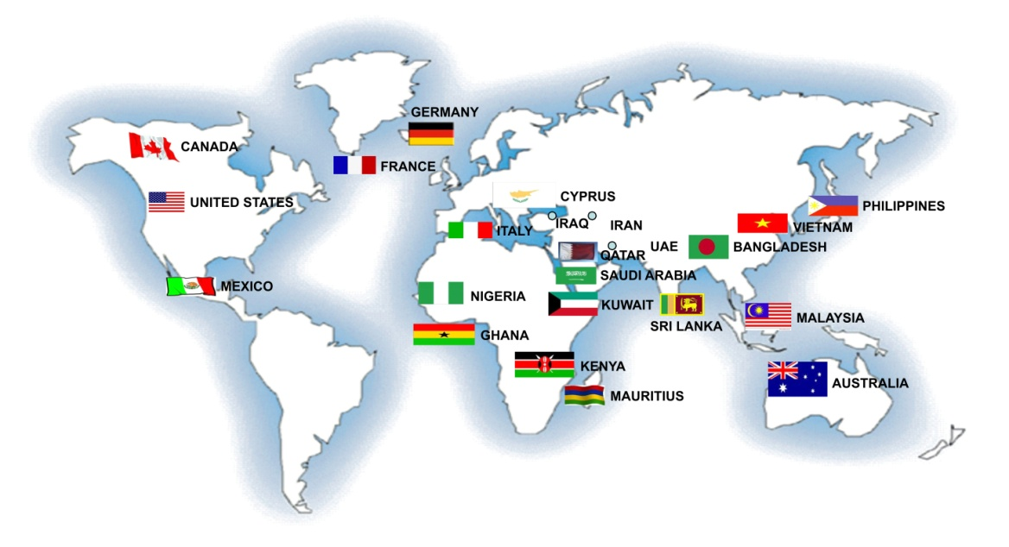
Key Strengths
Growing presence in exports
Established extensive international footprints across 45 countries
Strong order book for exports of Rs. 195 Crore

Slide 16
Industry Prospects
Global cable market reached USD 176 billion in 2013 demonstrating a CAGR of 4.7% from 2003 to 2013
Cable market in India was estimated at USD 3 billion in 2013, increasing at a CAGR of over 10%
Size of High Voltage cable > 132 kV is estimated at USD 300 million
Size of MV cable(11kV to 66kV ) and LV cable is estimated at USD 900 million & USD 1.8 billion respectively
Size of house / building wires is conservatively estimated at USD 800 million Planned addition in 12th five year plan - Generation capacity of 78,700 MV
Target of 85,000 MV capacity addition in 12th five year plan
Distribution Targets include electrification of 100,00 villages

Slide 17
Industry Prospects
Indian Power Sector
Additional capacity of 85000 MV of Power capacities required in next 6 yrs
Major policy investment initiative to achieve this growth
Thrust on Non-conventional energy like Wind Power, Solar
Total Investments of over USD 165 billion in Generation, Transmission & Distribution
Additional Cable Demand of USD 9 billion from this sector likely in next 6 yrs
Industrial Expansion
6-8% GDP growth momentum encouraging large investments in Industrial Sector
Major expansion in Sectors like Steel, Cement, Oil & Gas, Energy, Automobiles
Infrastructure, Housing
Major investments planned in Highways, Ports, Airports
SEZs
Rapid growth in Housing, IT Parks, Hotels, Shopping Malls, BPOs
Strong growth prospects for Cable demand in the Country

Slide 18
Industry Prospects

Slide 19
Growth Drivers
Power & Infrastructure
Infrastructure spending estimated at USD 1 trillion in the next five years
Estimated FDI in Infrastructure sector is USD 250 billion while USD 750 billion is expected to be mobilized locally
Demand for cables estimated at USD 3 billion (including EHV, MV and LV cables) used for transmission and distribution purposes
EPC
EPC industry is projected to be a multi-billion-dollar industry
On the threshold of exponential growth due to gigantic scale of infrastructure opportunities
Industry estimates suggest, for every rupee invested in power generation capacity, almost 60% is invested in equipment and EPC work
Consumption of cables in turkey EPC power project account for nearly 25% of the total project cost

Slide 20
Growth Drivers
Industry
Cables forms an integral part of every industrial capex
Cable requirement accrues only after 50% of the industrial project is complete
Demands are picking up with gradual recovery in expansion plans
Building & Construction
Demand for Urban Premium housing set to grow to Rs 757 billion in FY 20 from Rs 116 billion in FY 09
Demand for Affordable Housing
IT/ITES and BFSI sectors will lead to increased net absorption of office space
Office space forecasted to grow at a CAGR of 29.5% from 19.6 million sq ft in 2009 to 42.6 million sq ft in 2013
Demand for wires is expected to register a CAGR of 13% over the next 7-8 years

Slide 21
Business Overview
Retail
EPC
KEI
Institutional
EHV
Exports

Slide 22
Business Overview
Institutional
Presence in this segment is marked by:
Ability to offer multi-products, with a multi-location presence
Well-entrenched marketing presence across all states
Ability to deliver products fast across the country from plants in North and West
Servicing customers flawlessly
Building specialised offerings to tap niche segments such as shipping sector, oil and petroleum and solar plants even more aggressively
Tapping large realty brands
Strengthening all-India presence by embarking on opening new warehouses across the country

Slide 23
Business Overview
Servicing prestigious clients across diverse sectors evident from:
Power Sector Clients
Industrial Clients

Slide 24
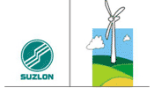
Business Overview
Servicing prestigious clients across diverse sectors evident from:
Refineries
Energy Sector

Slide 25
Business Overview
Servicing prestigious clients across diverse sectors evident from:
Fertilizer Sector
Steel Sector

Slide 26
Business Overview
Foray into EPC space
Commenced execution of EPC contracts
The main services offered by the company in the EPC segment includes execution of:
Power transmission projects of 66kV to 400kV substations on turnkey basis
EPC of EHV & HV cables systems
Electrical balance of plant system for power plant
Electrical industrial projects

Slide 27
Business Overview
The company’s key strengths in the EPC segment include:
Collaborations with Woosun Electric Co., Korea for power projects and Cobra Engineers, Spain for substation execution
Executing projects for some of the biggest names in the industry:
In house execution capabilities
Ability to manufacture own EHV cable / HV cable (which accounts for nearly 70% of its EPC project value)
Offer the entire range of products instrumentation cable, control cable and power cable
Strong marketing infrastructure and regional offices across all major cities in India

Slide 28
Business Overview
Servicing both the government and the private sectors
Average gestation period of such projects can range from 4 to 24 months
Aims to foray into other sectors like transmission line, infrastructure projects in the area of SEZ, MRT/Airport, EPC of cement plants, power plant and steel plant in the next 2-3 years
Key projects executed include:
EPC of HV Cablings system for JVVNL, Jaipur
MES for 100kV Transform and Electrical System of Air Force station, Gurgaon
Projects for power transmission utilities including projects for MSETCL, KSEB, TNEB, RVPNL
Projects for Reliance Infrastructure (400kV switchyard for 2x600 mw Thermal Power Project at Hissar
Industrial sector for AERENR, Ludhiana
Private utilities like Reliance, Tata Etc
RAPDRP/DDUGY Project at Mathura , Vrindavan & IPDS Project at Varansi

Slide 29
Business Overview
Strengthening EHV segment presence
New Line of 400 kV Commissioned at Chopanki Plant.
With commercial production, KEI is only third company in India to manufacture EHV cables
The demand for EHV cables in the country has so far been met through imports
Executed order of KPTCL worth Rs75 Crores.
Executed order of Rs.138 crore of Uttar Pradesh Rajkiya nirman Nigam Ltd.
Executed 220 KV EHV Project of Rs. 65 Crore of DMRC
Executed 220 KV EHV Project of Rs. 40 Crore of PGICL

Slide 30
Business Overview
Foray into the EHV segment is aided by the KEI’s Technological collaboration entered into with Switzerland-based M/s Brugg Kabel AG
Brugg enjoys over 100 years of experience and ability to manufacture cables up to 550 kV
Collaboration has enabled KEI a faster entry into the EHV cable market with designs, process back-up – services which are sought by end users
End-users of EHV cables includes transmission companies, mega power plants, metro cities, industries such as steel, cement, refineries, petrochemicals, large realty projects such as IT Parks, large residential complexes, etc
Presently more than Rs. 400 Crore orders of EHV Cable including Accessories and Erection & Commissioning is pending

Slide 31
Business Overview
Retail – domestic wires
Phenomenal progress achieved by the company in the last 6 years
Developed a strong reputation as the “power behind the power”
Established a clear positioning of a “specialist cable manufacturer”
The three pillars of trust & quality, brand awareness & customer service have resulted in robust growth
Added 137 (NET) New Dealer/ Distributor in the current financial year 2017-18 18 Dealer in Q1 18-19. Total 1302 Dealer’s network as on 30th June 2018.
Focused efforts and aggressive brand building initiatives have lead to increased house wire sales
Product and quality offering, specialist positioning and brand enhancing activities and strengthening of the distribution and dealership network leading to sales growth in FY17-18 & further in current financial year.

Slide 32
Business Overview
Exports
Presence in over 45 countries across the globe with focus on the oil & gas and utilities segment
Offers wide range of cables viz. EHV (66kV to 400kV), MV (11kV to 33kV) and LV (< 11kV) cables
Competitive pricing and ability to offer customised solutions and speciality cables
Export market is expected to at grow at rapid pace with opening of new branch offices
Strengthened prequalification parameters and achieved approvals for large projects with local companies in Middle East & South Africa & Australia
Part of various international exhibitions to establish new linkages and showcasing strong commitment to grow presence in the overseas market
Overseas offices in Singapore, Nigeria, Kazakistan and Dubai/Abudhabi, Gambia
And presence in Korea and Australia through Agent & Recently opened Subsidiary Co. in Australia
Strong order book of Rs. 195 Crore of Export

Slide 33
Future Outlook
New Industrial cable
Presence across complete range of cables up to 400kV
Enhanced capacities
Turnkey
EPC solutions
Widest range of power & instrumentation cables
Focused approach in its domestic house wires and EHV segment
Key technological tie-ups with Brugg Kabel A.G.
Experienced & trusted brand name
Delivering growth

Slide 34
Financials
Rs. In Crores
 | FY 12 | FY 13 | FY 14 | FY15 | FY16 | FY 17 | FY 18
Net Sales | 1722 | 1658 | 1619 | 2024 | 2325 | 2669 | 3446
PBDIT | 152 | 173 | 154 | 197 | 248 | 279 | 348
PBT | 36 | 43 | 22 | 53 | 95 | 126 | 204
PAT | 24 | 26 | 12 | 34 | 62 | 94 | 145
Net Fixed Assets | 318 | 311 | 314 | 302 | 356 | 406 | 427
Net Worth | 227 | 256 | 273 | 304 | 363 | 461 | 605
Total Debt | 471 | 465 | 509 | 433 | 509 | 640 | 642
Buyer Credit | 17 | 9 | 2 | 20 | 52 | 140 | 138
ROCE (%) | 19 | 21 | 18 | 22 | 27 | 28 | 31
ROE (%) | 11 | 12 | 5 | 13 | 19 | 23 | 27

Slide 35
Financials
Rs. In Crores
 | Q2 (16-17) | Q3 (16-17) | Q4 (16-17) | Q1 (17-18) | Q2 (17-18) | Q3 (17-18) | Q4 (17-18) | Q1 (18-19)
Revenues Net | 635 | 728 | 746 | 778 | 749 | 889 | 1030 | 884
PBDIT | 69 | 78 | 81 | 78 | 77 | 91 | 100 | 87
PBT | 30 | 37 | 43 | 40 | 42 | 58 | 64 | 50
PAT | 23 | 27 | 32 | 27 | 28 | 39 | 50 | 32

Slide 36
Financials
Rs. In Crores
Net Sales | Q2 (16-17) | Q3 (16-17) | Q4 (16-17) | Q1 (17-18) |  | Q2 (17-18) | Q3 (17-18) | Q4 (17-18) | Q1 (18-19)
Domestic | 326 | 429 | 426 | 439 |  | 363 | 467 | 581 | 479
Dealer | 206 | 183 | 248 | 229 |  | 249 | 313 | 352 | 326
Export | 103 | 116 | 72 | 110 |  | 137 | 109 | 97 | 79
Total | 635 | 728 | 746 | 778 |  | 749 | 889 | 1030 | 884
LT Cable | 290 | 323 | 338 | 304 | 307 |  | 396 | 408 | 314
HT Cable | 103 | 98 | 99 | 106 | 116 |  | 115 | 161 | 149
EHV | 18 | 32 | 37 | 59 | 20 |  | 38 | 52 | 39
HW,WW | 103 | 101 | 131 | 105 | 131 |  | 141 | 187 | 180
SS Wire | 25 | 26 | 29 | 27 | 30 |  | 29 | 30 | 31
EPC other Than Cable | 93 | 141 | 102 | 174 | 137 |  | 160 | 186 | 158
Others | 3 | 7 | 11 | 3 | 8 |  | 10 | 6 | 13
Total | 635 | 728 | 746 | 778 | 749 |  | 889 | 1030 | 884

Slide 37
Financials
Rs. In Crores

Slide 38
Financials
Rs. In Crores

Slide 39
Financials
Rs. In Crores

Slide 40
Future Growth Driver
F.Y. 2018-19 Additional turnover of approx Rs. 175-200 Crore from Retail market, approx. Rs. 100 Crore from EPC & Rs. 150 Cr from EHV Cable apart from normal growth in existing range of cable.
Expansion of House Wire and Flexi Wire for Retail & Distributor started in Silvassa on rented premises
Expansion of EHV Cable up to 400 Kv completed
Expansion in Existing Product Range : LT Cable completed at Pathreri and HT cable at Pathreri started
Expansion of Dealer/ Distributor in a big way.
Expansion of Export market in a big way.

Slide 41
Shareholding Pattern

Slide 42
Thank You !
www.kei-ind.com

